Slide 1
PES/PELS/IAS/IES Austin (PI)² Tech Meetings on 4th Tuesdays, Jan - Oct

Slide 2
2017 ChapCom
Chair – James J. Mercier, P.E.
Vice Chair/Chair Elect – Steve Pearson
Treasurer – Kris Dehnel
Secretary – Ruth Sulzer, P.E.
Member–at–large – Marcie Gard, P.E.
Member–at–large – Barry Bell, P.E.
Member–at–large – Franklin Bohac, P.E.
Comm Chair – Steve Pearson

Slide 3
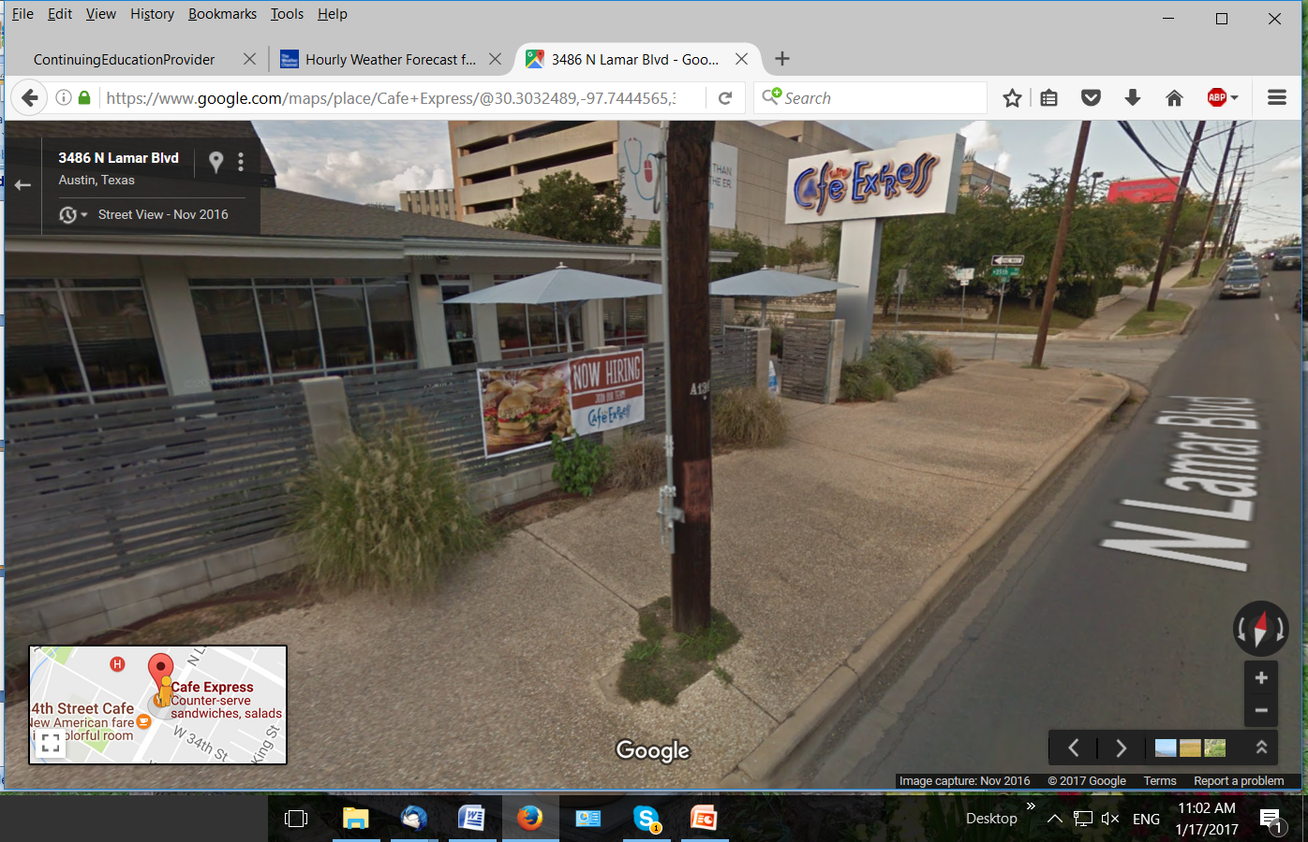
NEW MEETING LOCATION!

Slide 4
Strengths
10 Tech meetings with varied topics
11 Chapcom meetings
2 Workshop (one more than 2016)
4 tours
2 socials (one more than 2016)
2 ${(PI)}^{2}$ Engineer of the Year awards

Slide 5
Weaknesses
Declining attendance - Austin Traffic?
Website upkeep

